Slide 1
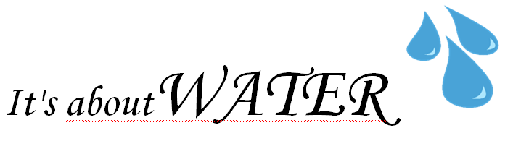
Mount Air Community Meeting
Tuesday, November 13th 6:30-7:30pm at Sharon Township Hall

Slide 2
History of Water in Mount Air
Pre 1961 all homes on individual wells
Community water System created in 1961.
Houses added over time as individual wells failed.
Currently 49 properties serviced out of appx 80 homes in Mt. Air.
Last major upgrades performed in 1980’s
Expected life cycle 30 years was surpassed 7-8 years ago
We need a Long Term Solution for 2020 and beyond.

Slide 3
History of Water in Mount Air
This Project is not just about the Mount Air Community Water system but that is the most urgent Driver for Change.

Slide 4
Current Challenges
Infrastructure
  Aging Distribution pipes = frequent breaks and potentially costly repairs.
  Does not meet current standards
    3” and 2” Mains
    PVC not not rated for 80psi – 90psi operating pressures
    Lack redundancies and isolation valves
    Some areas are not deep enough
    Non-standard sizes and couplings

Slide 5
Current Challenges
Future of volunteer labor is uncertain
System requires licensed operator
  Currently Operator retiring. A Mount Air Resident is training but not yet licensed.
  Previous Quotes for commercial operator 3x current cost (not including daily testing).
EPA standards increase. - Push toward centralized professionally managed water systems.

Slide 6
We CANNOT
Do Nothing - Just keep patching - Not Sustainable Long Term – EPA Compliance.
Re-build Distribution System - Requires updating to current EPA Standards $$$
Return to individual wells - Many Properties cannot site a well or may not access good water

Slide 7
WE DO Have an OPPORTUNITY!
  Pending approval from City of Columbus for access to Delco System
  Sharon Township Support!
    Experienced and Quailfied Legal Council
    Potential Water District or Community Development Corp.
    Standing to apply for Funding
    Entity that can Contract for Infrastructure

Slide 8
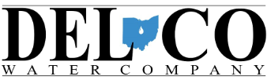
WE DO Have an OPPORTUNITY!

Slide 9
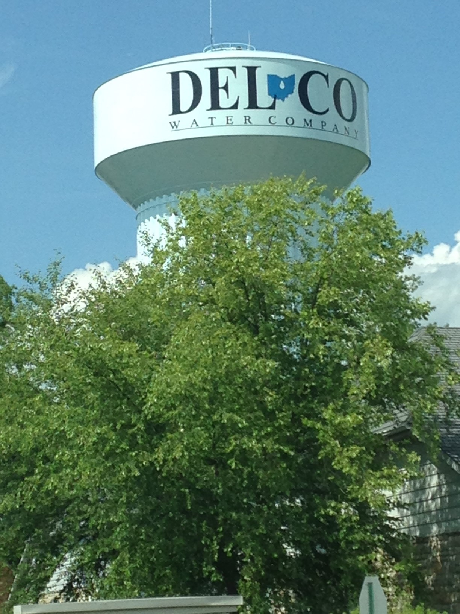
Mt. Air Community
November 2018
Glenn Marzluf, PE
Del-Co Water Company

Slide 10
Del-Co Water Company
General Information
Member (Customer) ownedNon-For-Profit
Corporation
Governed by a Board of 10 Directors
Served 1st customer in 1974
Grown to largest rural system in Ohio
  Population 140,000
1800 mi of pipe over 800 mi² in 7 Counties
(Delaware, Morrow, Marion, Knox, Franklin, Union and Crawford Counties)

Slide 11
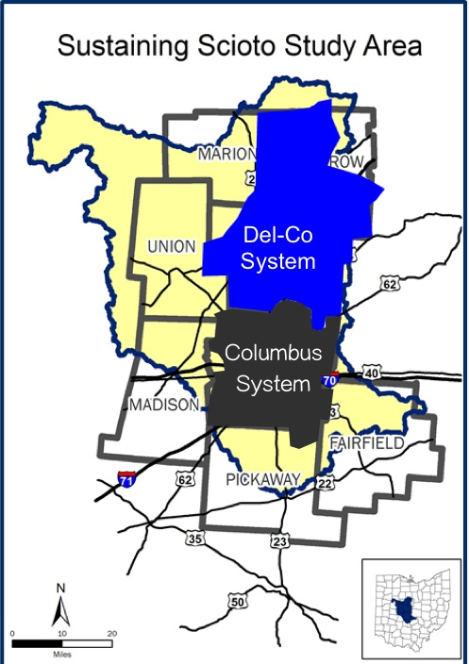


800 sq mi
Pop 140,000
1920 mi pipelines
4 water treatment plants
11.5 MGD
approx. 400 sq mi
Pop 1,139,000
3600 mi pipelines
3 water treatment plants
140 MGD

Slide 12
Del-Co Water
is a not-for-profit water cooperative which provides sustainable water services to improve quality of life to our customers and provide for economic development.
multi-county regional water system which serves a population base of over 140,000.
By regionalizing water services, we can keep rates affordable.
Our staff is experience and skilled in water. That’s all we do.

Slide 13
How can it help Mt. Air
HOA?
Provide
Provide safe and reliable water service.
Eliminate
Eliminate the need and costs associated with employing a water operator and being a regulated utility
Eliminate
Eliminate the need for the neighborhood to face independently challenges related to water for aging infrastructure, lack of financial resources, and attracting and retaining qualified staff.
Eliminate
Eliminate the volatility of costs associated with lost-water, water main breaks, and other infrastructure challenges.
Reduce
Reduce scope of HOA by reducing one major service component of the village.

Slide 14
For Mt. Air residents
All residents who want water service would become members of Del-Co Water.
Del-Co’s non-profit status provides peace-of-mind that residents are not paying dividends to a for-profit stakeholder(s)
Access to customer service Monday through Friday 8:00 am – 4:30 pm, to web portal 24-hrs with bill history and many payment options
Provided an after-hours call center and staff for 24hrs x 365-days in emergency
governed by our rules and regulations, reduced flexibility on metering, billing, etc…
required to provide easements to Del-Co to relocate point-of-metering to outdoor

Slide 15

Costs?
residents would pay Del-Co Water for all the investments necessary to connect the existing system and make it viable and sustainable.
  Possible ways to pay:
    increased tap fees
    “special rate” on a water bill,
    a partnership with the township or county or other organization
    Grants / loans
current tap fee/ capacity fee ($5,400 for a typical 5/8” meter, as of 6/1/18) may be modified to make it work properly for this merger.

Slide 16
Transmission line west of neighborhood
Avoids major construction on SR-315
Avoids significant tree clearing along SR315
Fewer long-service installations
Less utility relocation
Estimated costs: $650K to $1.65MM
Requires easement west of Mt Air
Rock risk is slightly lower

Slide 17
Transmission line down SR-315
Major construction on SR-315
Significant tree clearing along SR315
Reduces feet of pipe and hydrants, etc…
Reduces pavement repair / replacement
Estimated costs: $770K to $1.70MM

Slide 18
Level-of-magnitude cost scenarios
Best case
Experience little rock excavation
Use scenario Option A
Assumes no-cost easements
Total costs:
  $700K water system installation
  Reduced tap fee of $3000
  30 homes: $26,000 +/- per home
  40 homes: $20,000 +/- per home
  50 homes: $17,000 +/- per home
  60 homes: $14,000 +/- per home
Worst case
Experience rock excavation
Use scenario Option A
Assumes no-cost easements
Total costs:
  $1.7MM water system installation
  Reduced tap fee of $3000
  30 homes: $60,000 +/- per home
  40 homes: $45,000 +/- per home
  50 homes: $37,000 +/- per home
  60 homes: $31,000 +/- per home

Slide 19
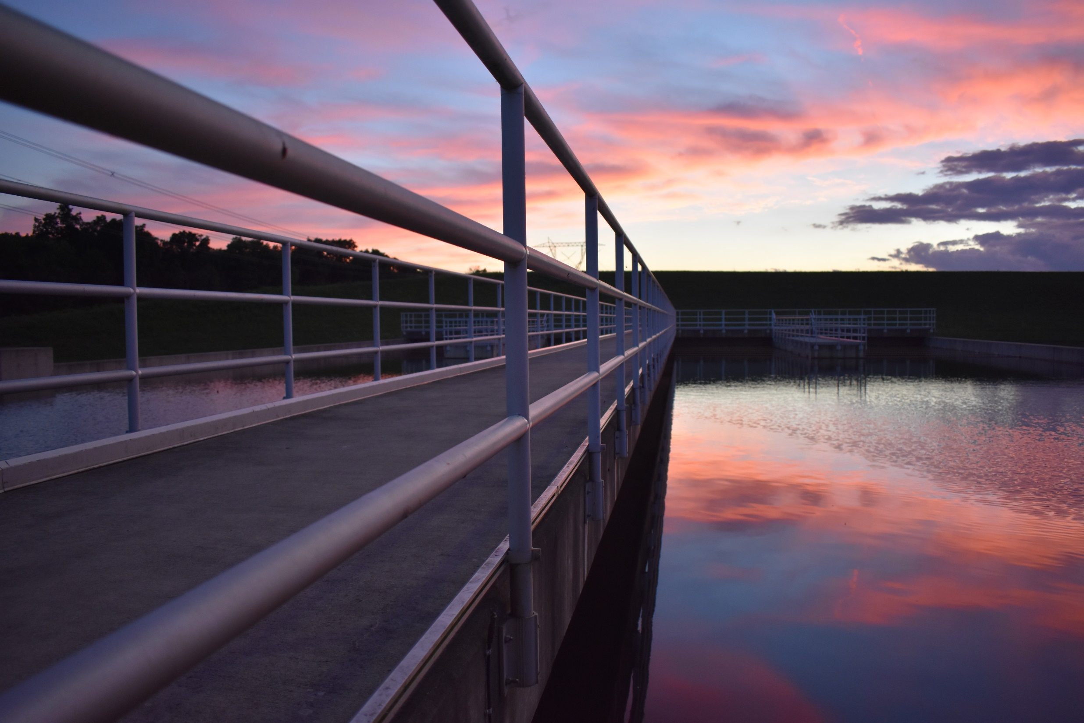
Questions??
Glenn Marzluf, PE
Del-Co Water Company
gmarzluf@delcowater.org
www.delcowater.org
740-548-7746

Slide 20
What are we asking for tonight?
Your Support

Slide 21
An Opportunity for ALL of Mount Air
Centralized water connection
Protects/raises home values in our neighborhood
Assures consistent and safe water utility long-term
Gives predictable costs
Removes burden of operations and repairs currently done by neighbors
Is supported by multiple funding avenues
Increases safety and reduces HO insurance due to hydrants

Slide 22
Many Resources Got Us Here
Thanks to:
City of Columbus, for allowing DelCo to serve us
  Removes annexation requirement
  Cost would easily double
State Rep Mike Duffey, for his tireless efforts and HB 602
Franklin County Commissioner Kevin Boyce, for his advocacy
OhioEPA, for advocacy and emergency loan funds
John Albers, for his expertise in this area
Sharon Township leadership and residents, for their support

